Slide 1
NORMALIZATION
Image: http://blogs.cdc.gov/genomics/files/2014/07/2014-07_feature_home2.jpg

Slide 2
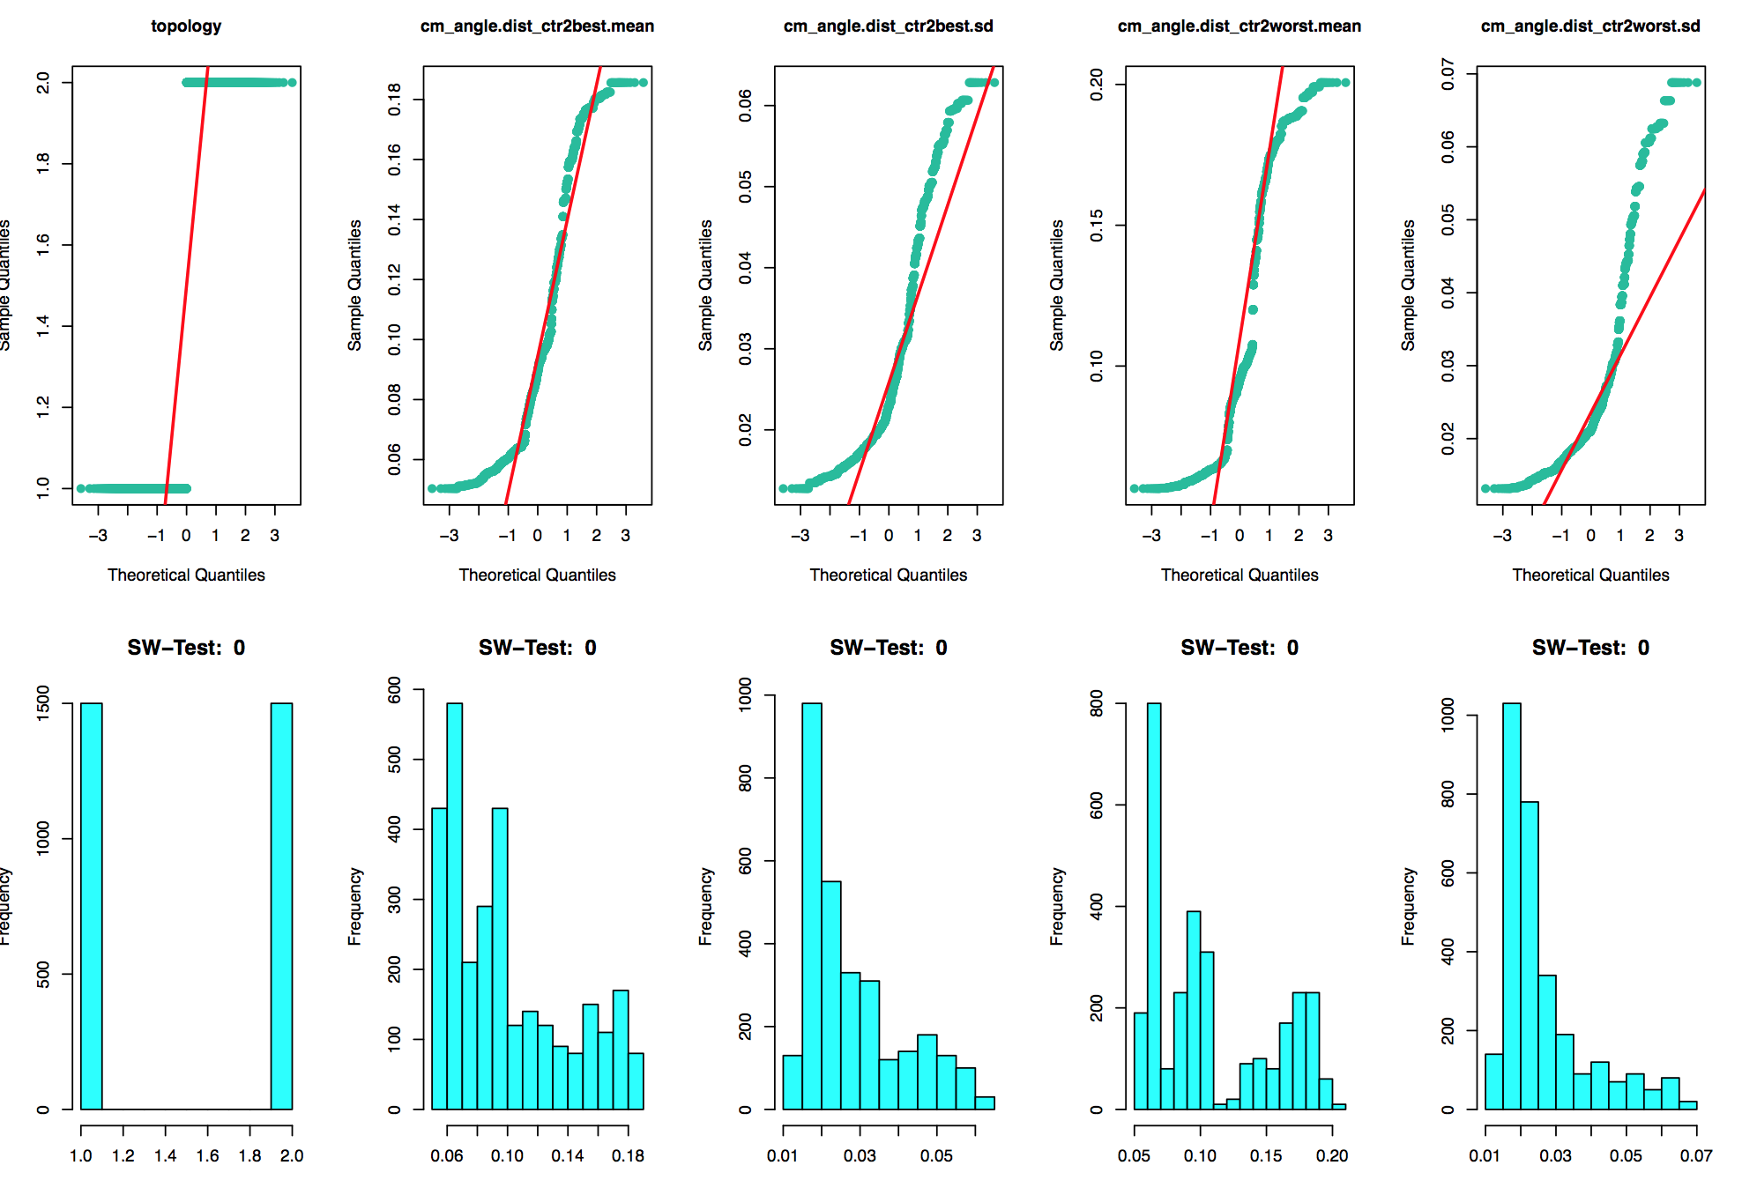
Normality
Shapiro-Wilk test applied to each individual set of features (α=1%)
→ p-values < 0%

Slide 3
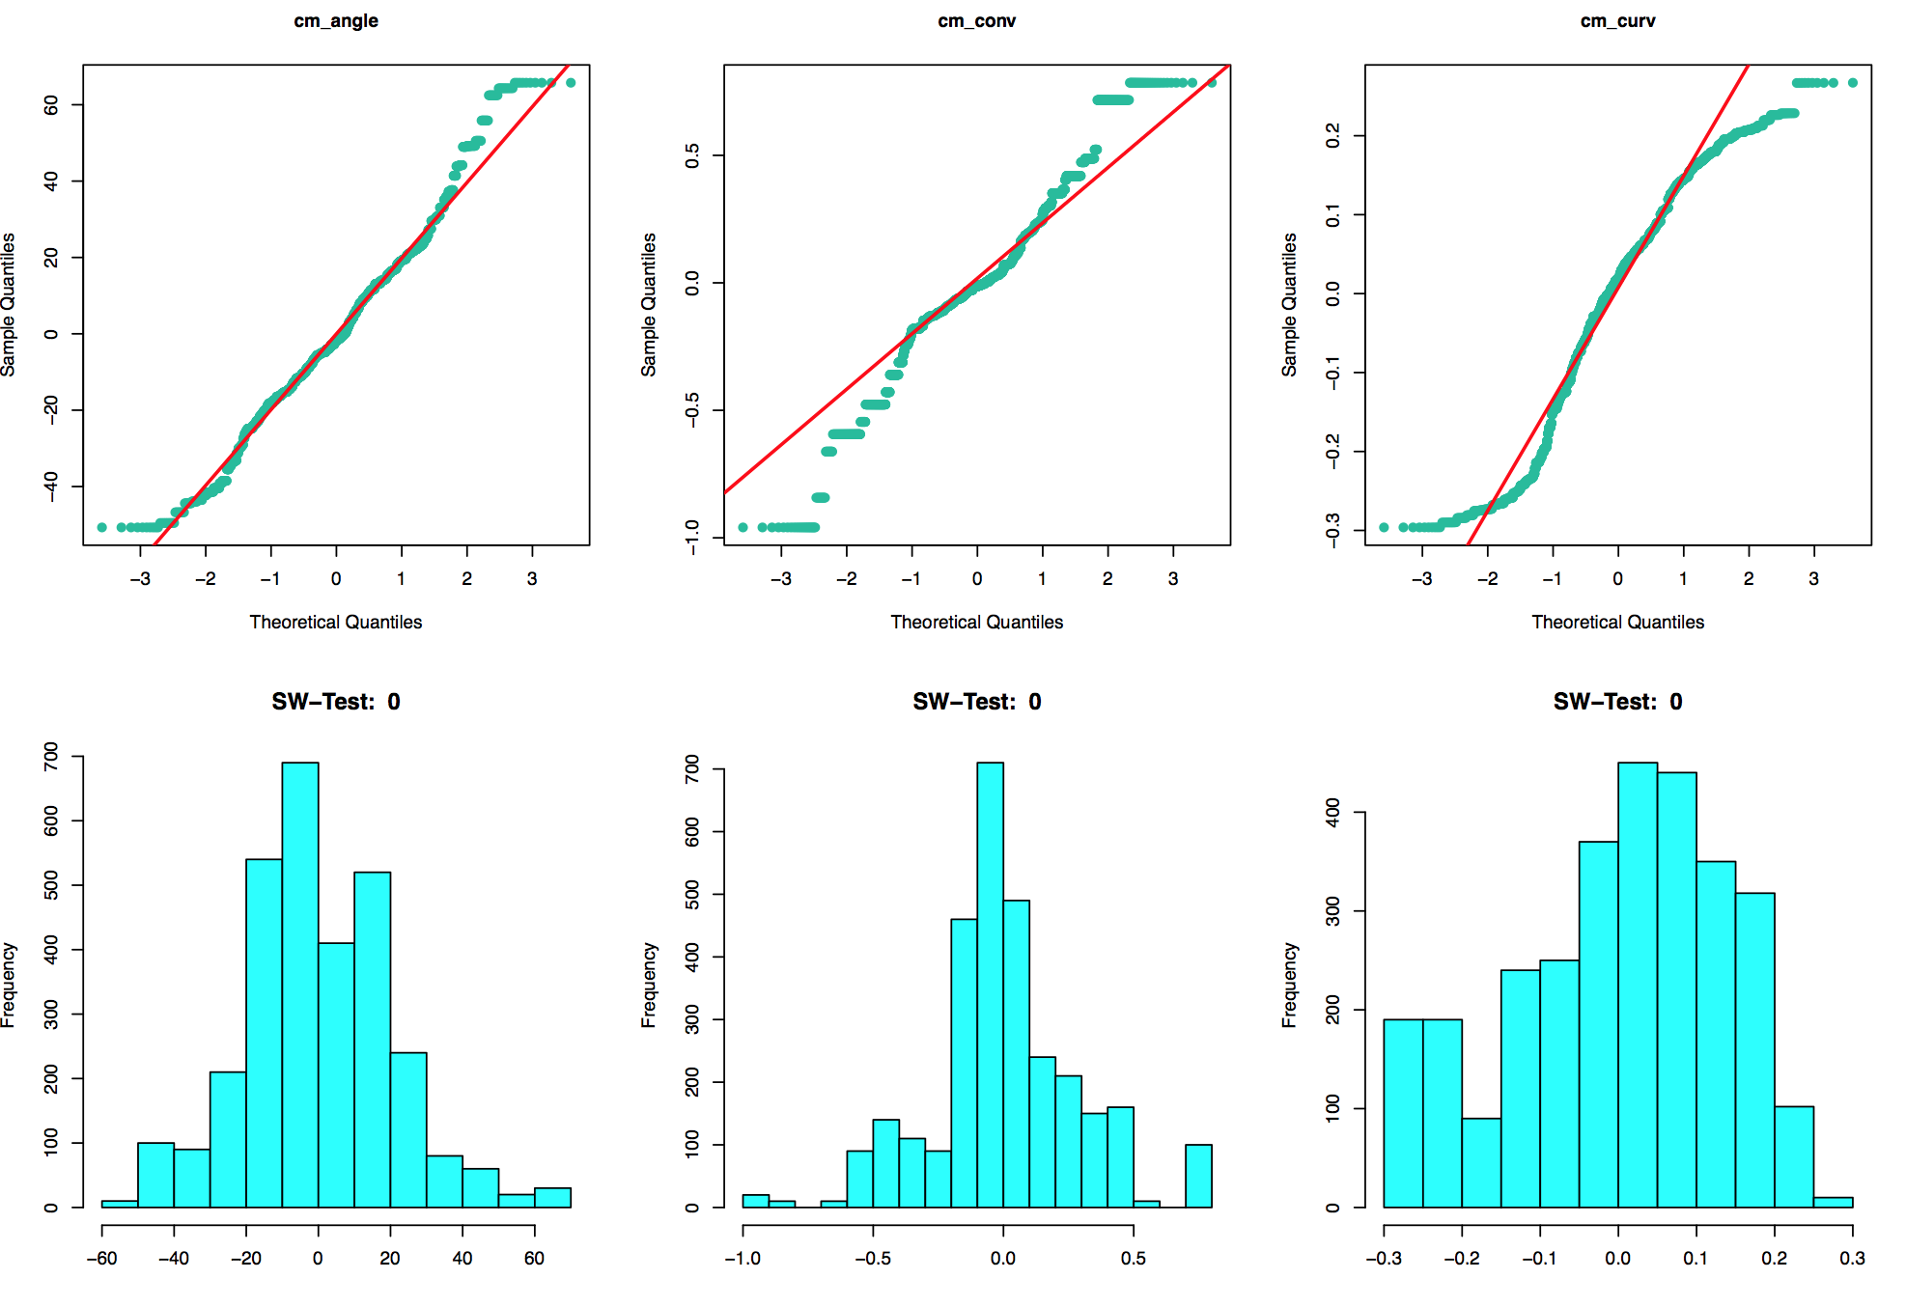
normality
A possible explanation:
Repetition of observations (x10)
Block settings (x3)
Normal distribution is also not assumed during tests to the PC of the features groups
Notes:
not entirely ‘random’ generated, thus being independent and identically distributed does not apply
every problem instance is executed 3 times with different blocks setting# however for most features they retrieve each time the same value#Therefore when testing normality (for assuming the instances being iid) the subgroups should be analyzed separately

Slide 4
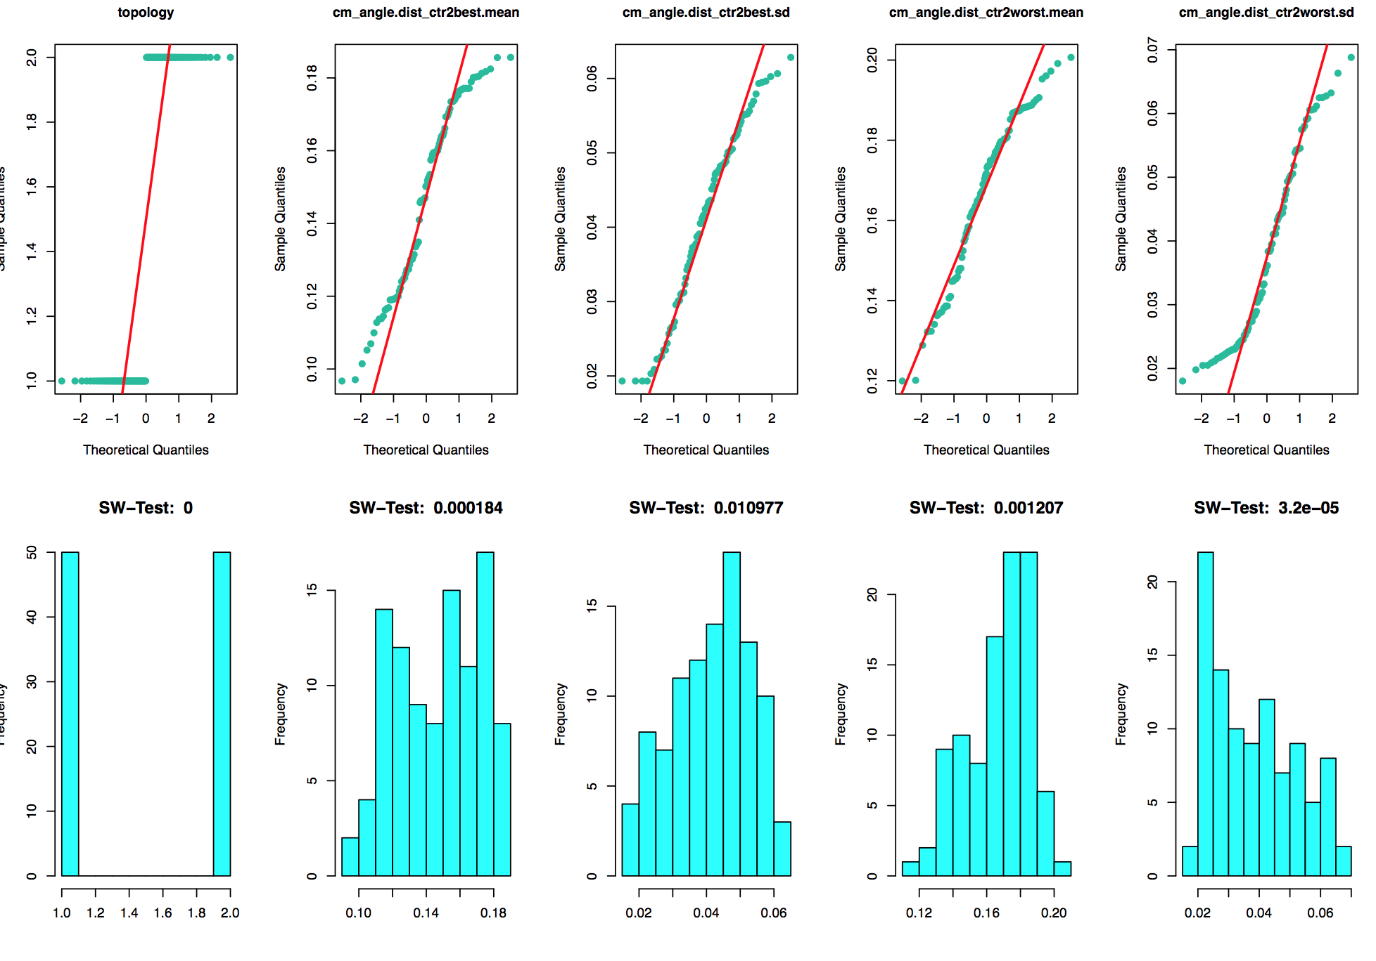
normalization
Double Clicking
Take 1 repetition within the same block instance
→170ix improvement of the SW-Test mean P-value of the subgroups vs. whole data-set
Notes:
mvShapiro.Test(as.matrix(bfeats.ela_local))$p.value – does not work?
P-value 3.86% vs. 0.00261%
#cm_angle.dist_ctr2best.sd 1.10% #cm_angle.angle.mean 1.12%#cm_angle.angle.sd 4.44%#ela_curv.grad_scale.lq 99.32%#ela_curv.grad_scale.med 12.36%#ela_curv.hessian_cond.lq 89.07%#ela_curv.hessian_cond.uq 8.32%#ela_curv.costs_fun_evals 7.15%

Slide 5
normalization
Looking at the 30 subsets for the feature, some could not be rejected for not being normally distributed
Subset | p-value
cm_angle.dist_ctr2best.sd | 1.10%
cm_angle.angle.mean | 1.12%
cm_angle.angle.sd | 4.44%
ela_curv.grad_scale.lq | 99.32%
ela_curv.grad_scale.med | 12.36%
ela_curv.hessian_cond.lq | 89.07%
ela_curv.hessian_cond.uq | 8.32%
ela_curv.costs_fun_evals | 7.15%

Slide 6
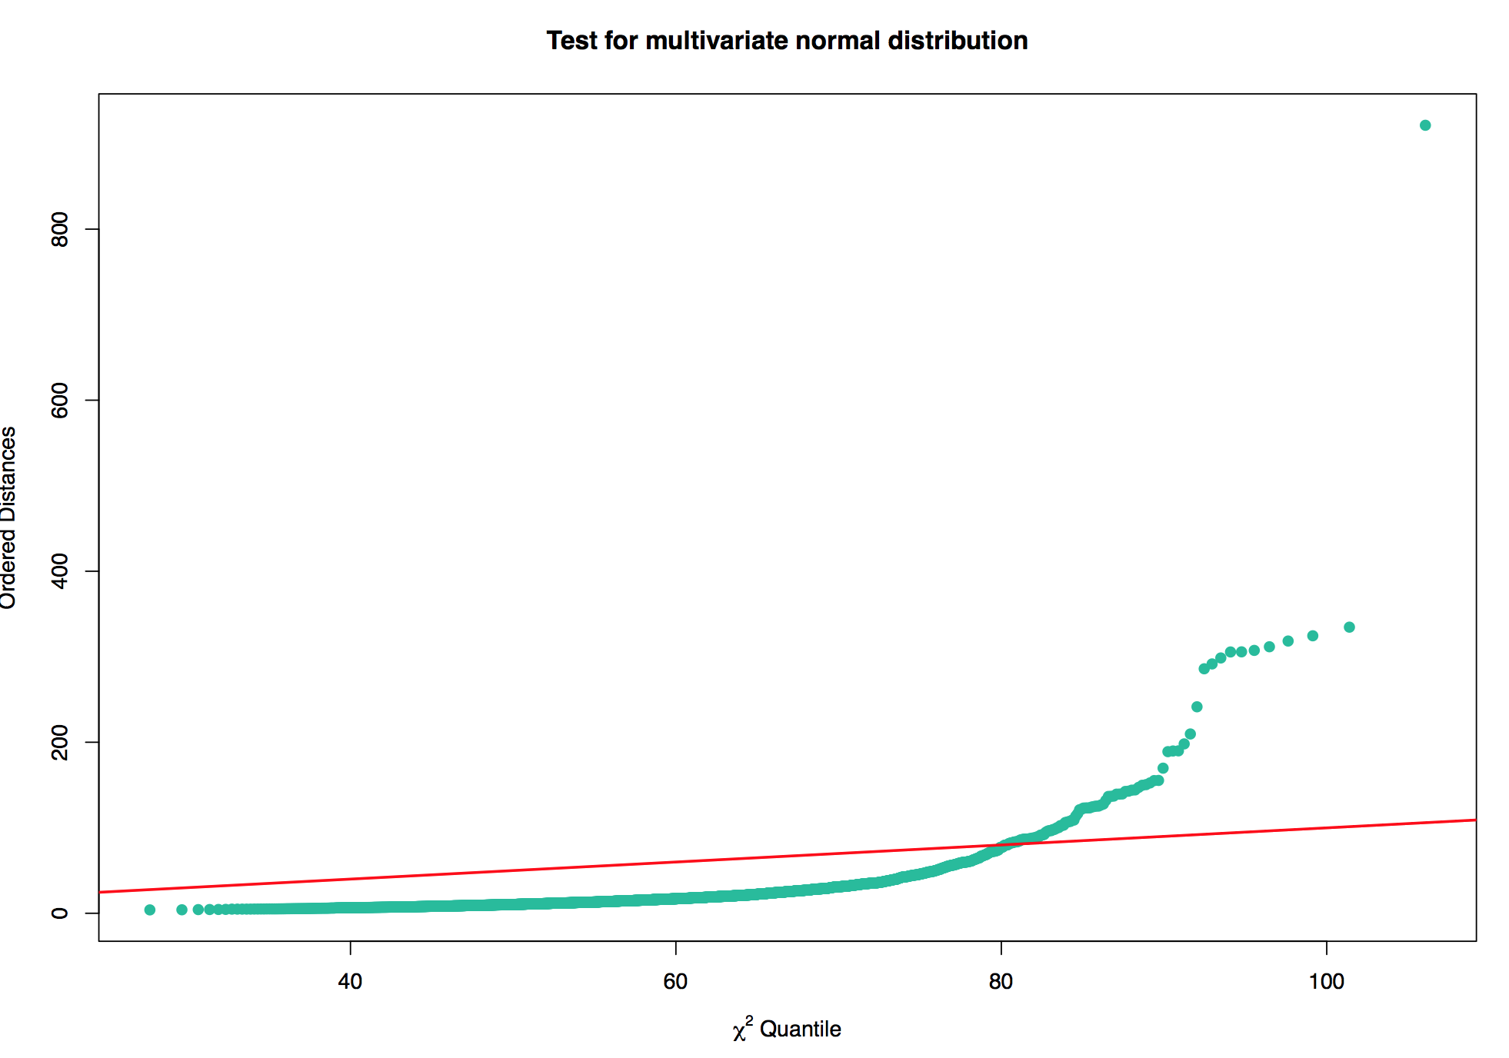
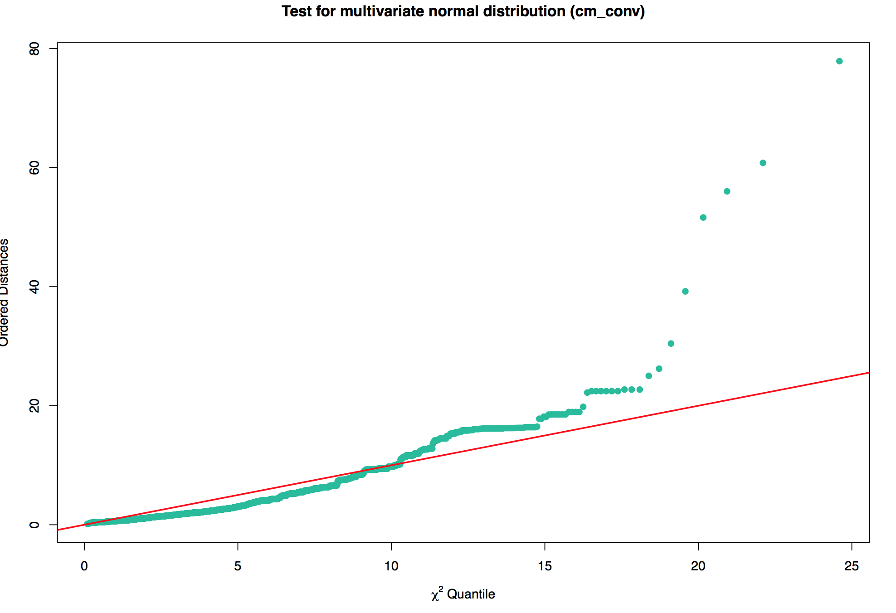
normalization
Multi-variate distribution
Visualization using the Chi-sq plot applied & SW-Test → not normally distributed
Applied to the subgroups also delivers the same results
→ p-values < 0%
→ p-values improve, but tend to 0
Notes:
Again looking at specific block subset and one repetition the values improve, but the H0 is not rejected.

Slide 7
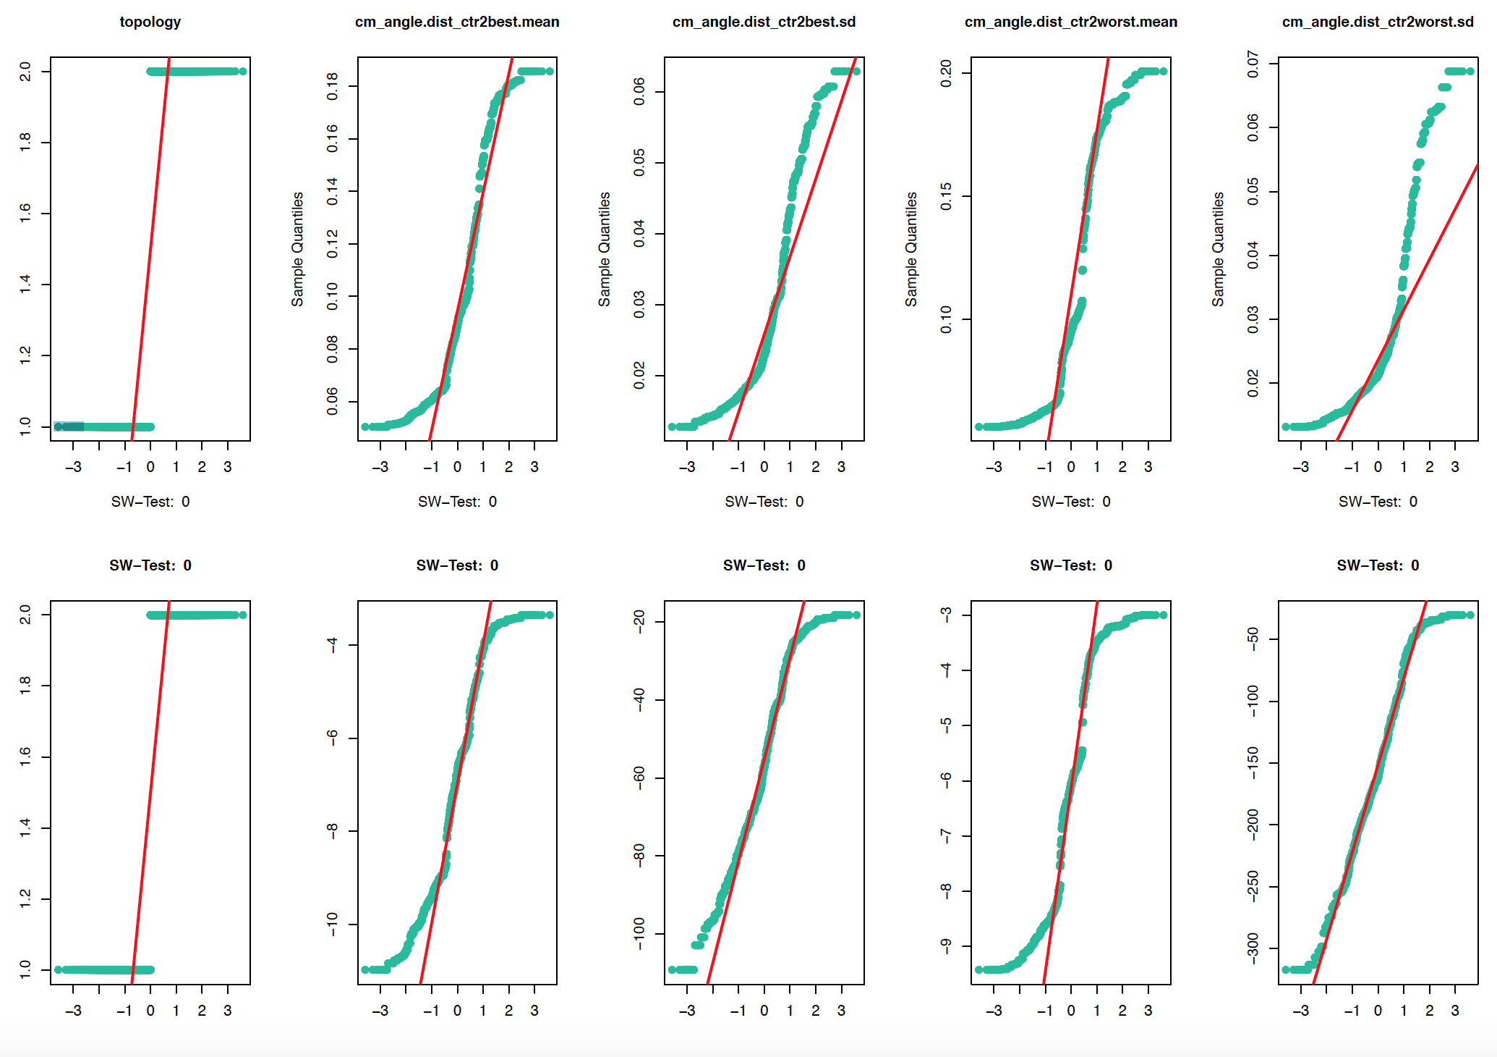
Normality
Transformation to normality
Box-cox transformations for the whole data set
→ SW-Test mean p-value increases to 1.621%
Features showing a p-value > 1%:
ELA_curv feats:
grad_scale (lq, med, uq)
hessian_cond.lq

Slide 8
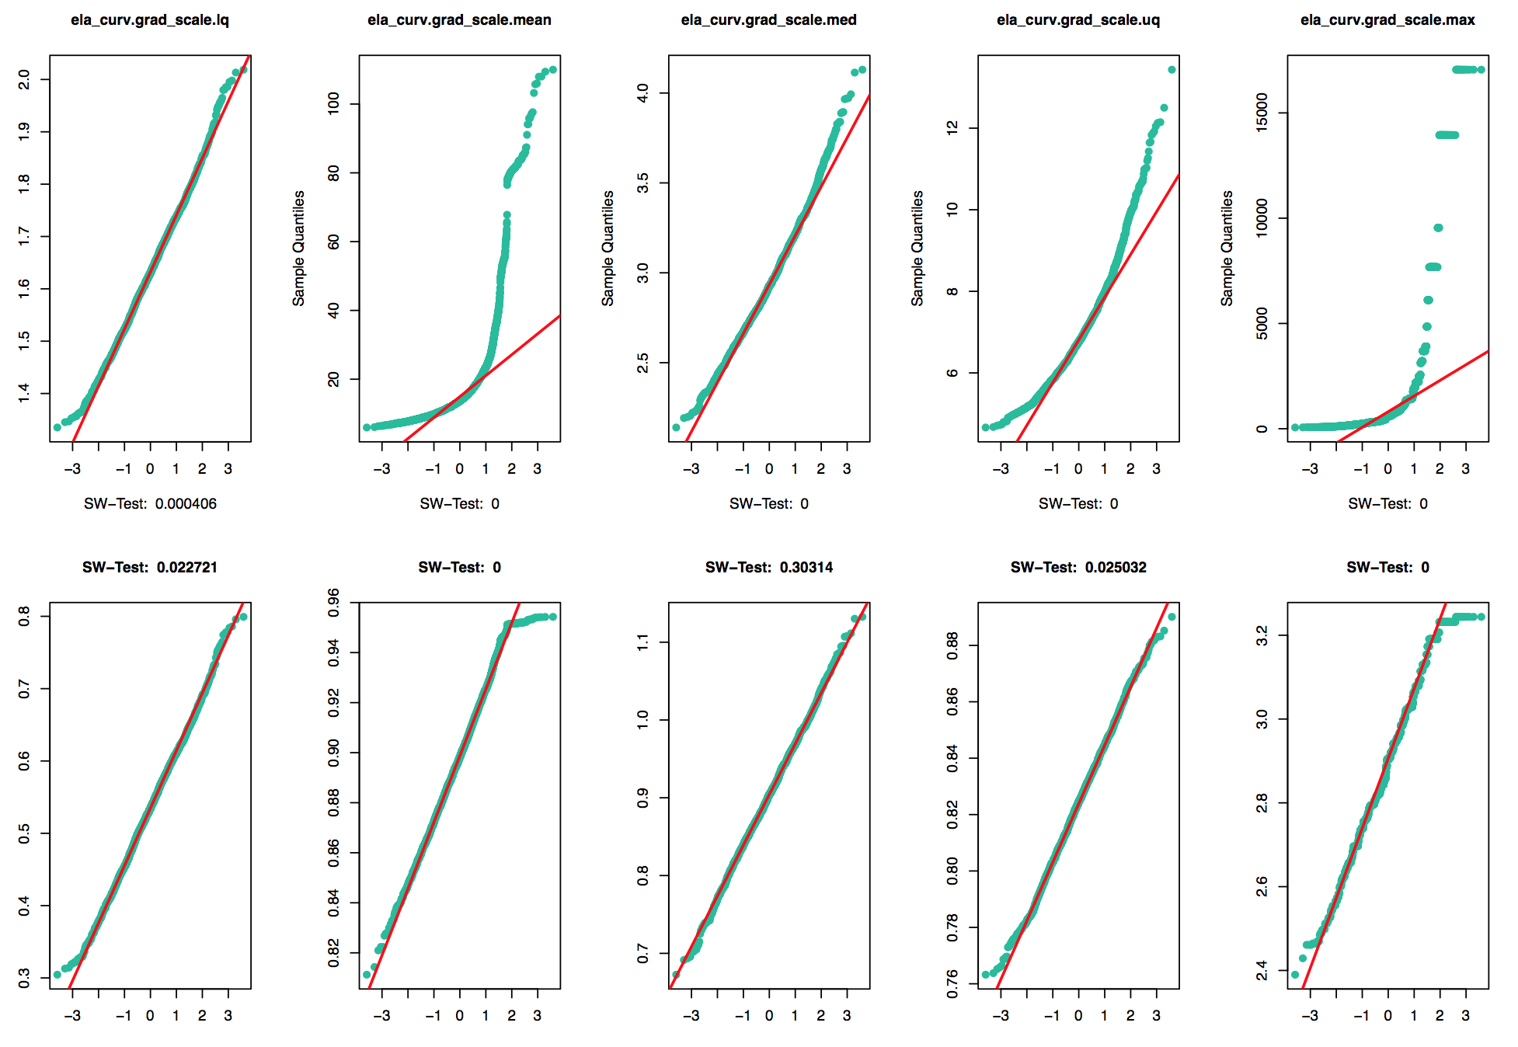
normality
Significant changes for some features

Slide 9
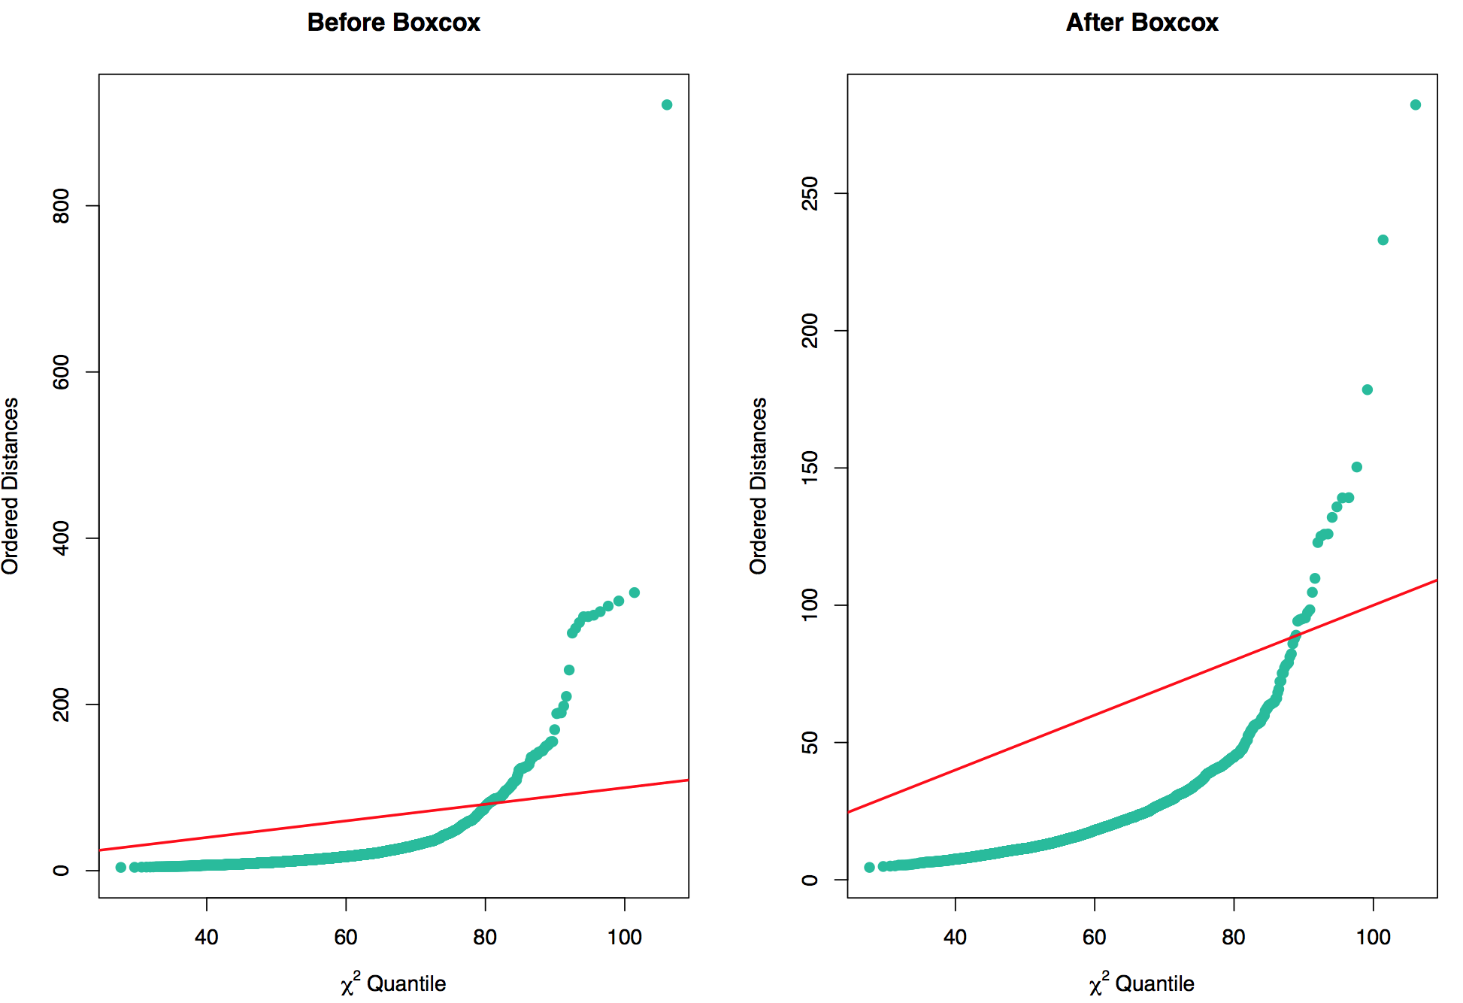
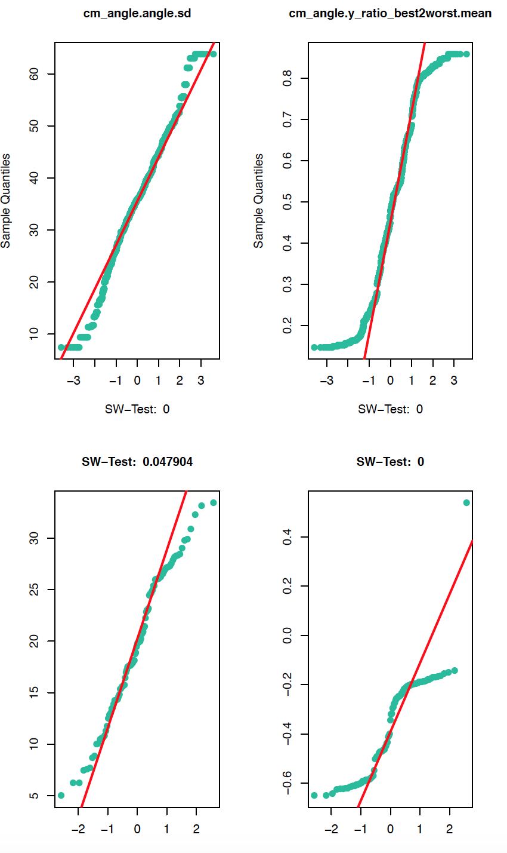
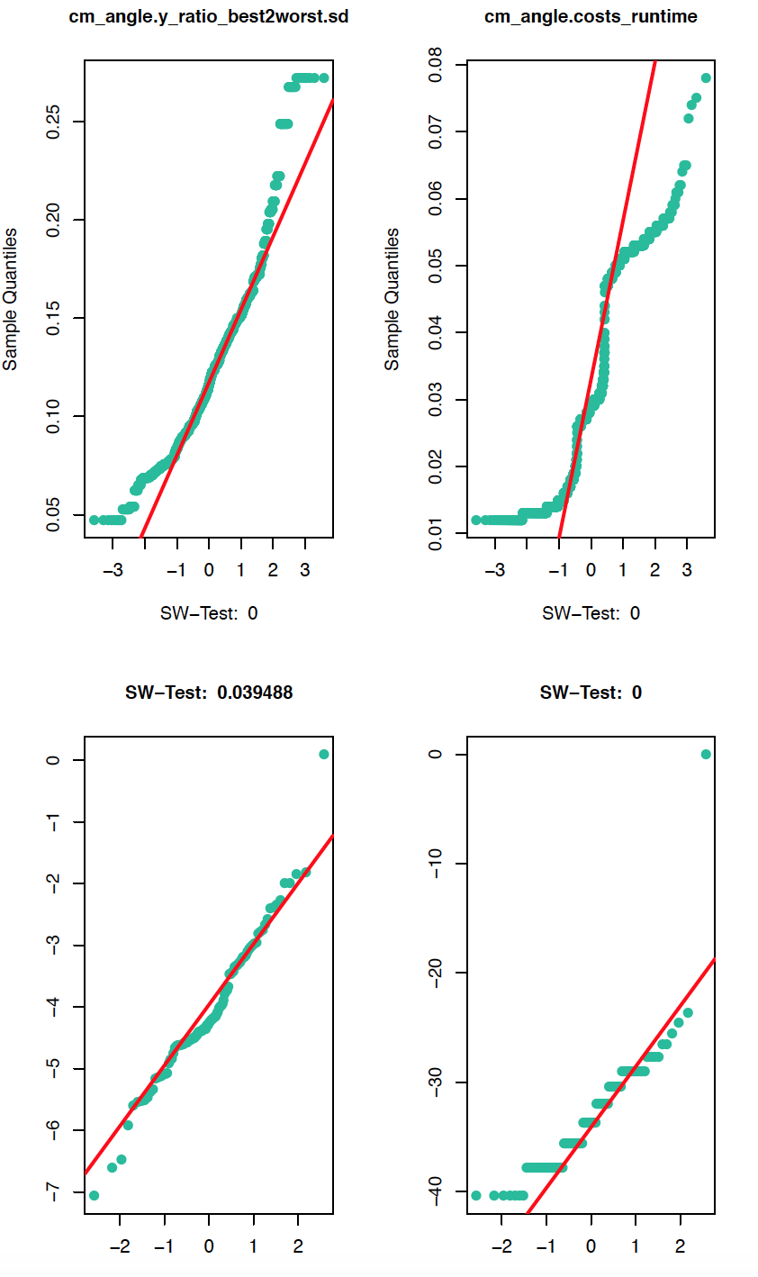
normality
Multi-variate distribution
The transformation improvement can also be observed for the multi-variate case
Applying SW-Test for the subsets of these transformed data however didn’t necessarily improve the results
→ SW-Test mean p-value decreased to 0.0103%
Notes:
Looking at the distances

